Slide 1
Huff Research Group Kendra Andersen
Project Summary 11/6/17

Slide 2
Project Description
Navigation in Radio Frequency Landscapes using Autonomous Vehicles and Multiple Antenna Systems
Collect data on signal strength of various antenna systems using autonomous rovers.
Develop algorithm to plan a route for the rover which maximizes received signal strength (RSS).
Develop control strategy to examine signal strength at various frequencies for a GPS location and determine the best antenna configuration to maximize RSS.

Slide 3
Status
Completed:
To be completed:
Ensure all rovers operate autonomously.
Began collecting real-time RSS data with Ryan.
Began development of path planning algorithm with test data sets.
Gather more RSS data using the rovers.
Update the path-planning algorithm to use real data and to determine optimal paths in real-time.
Development of control strategy to make decisions about the best antenna system for a location.

Slide 4
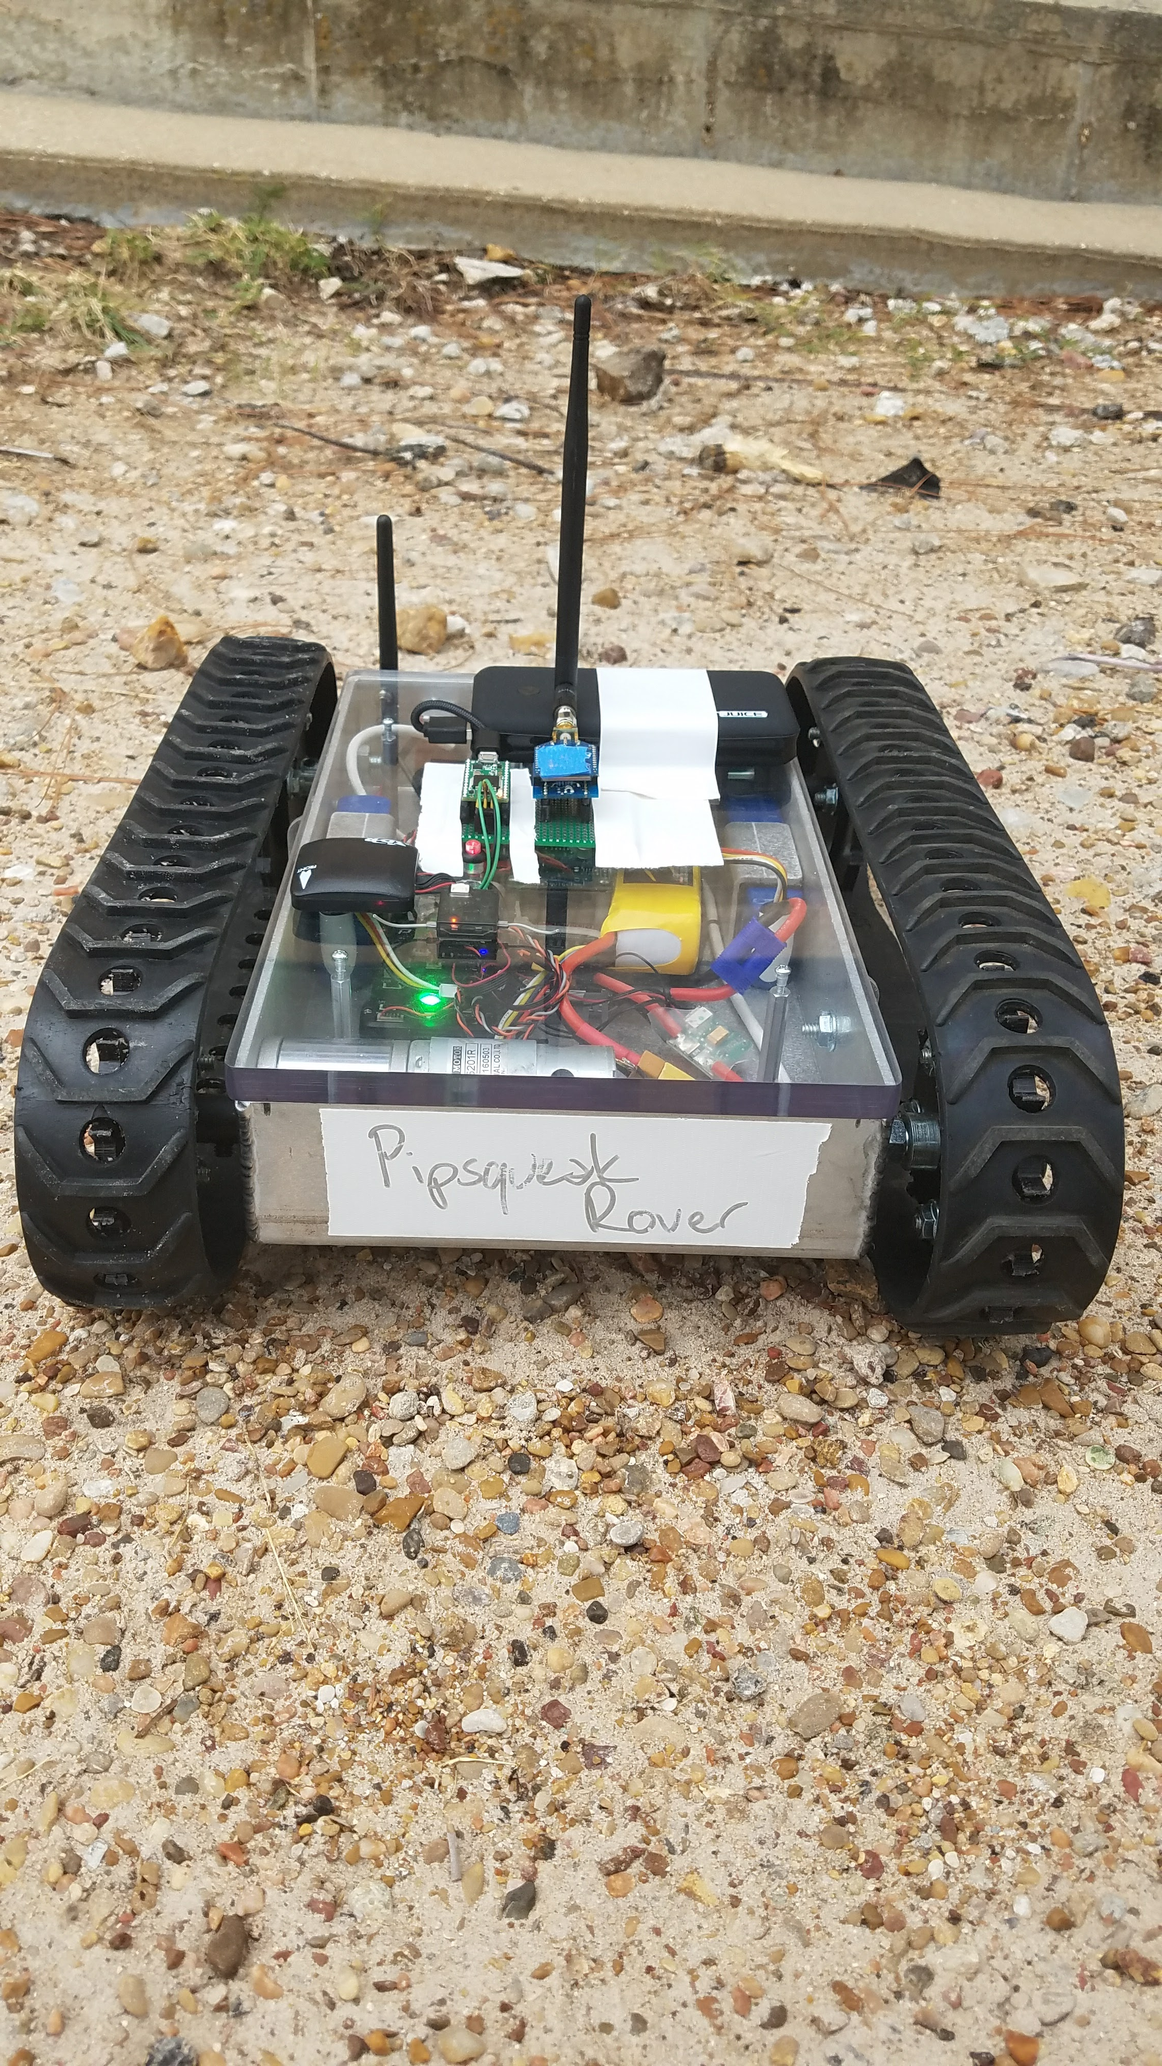
Data Collection Setup on the Autonomous Rover
There are three autonomous rovers being used for this project. The picture is of the smallest rover.
Hardware:
Inside the case, there is a pixhawk used for the autonomous functionality of the rover.
The board mounted on top is a Teensy which communicates RSS information back to a laptop using an Xbee.

Slide 5
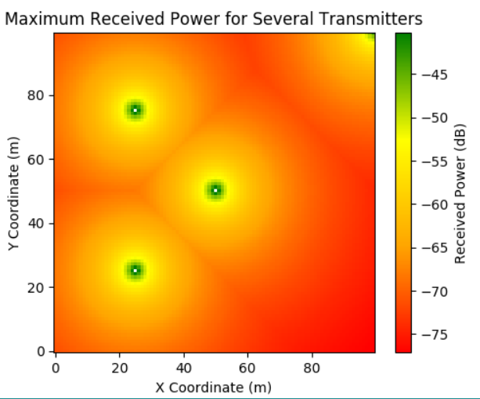
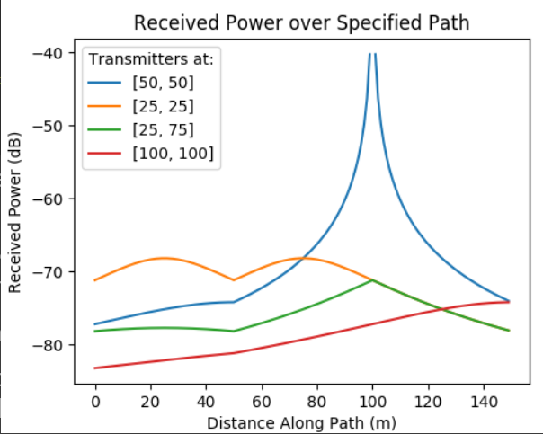
Findings/Progress

